Slide 1
Important Concepts

Slide 2
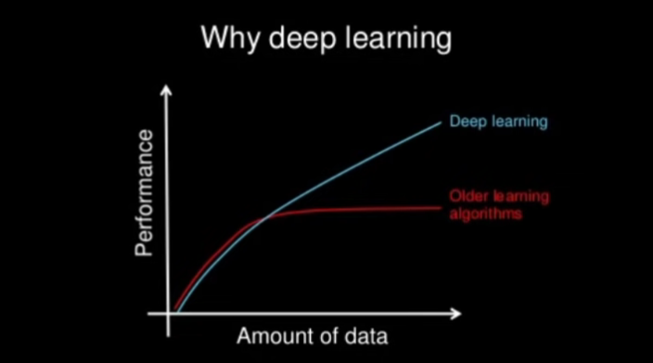
Contents
Deep learning - Introduction and intuition

Slide 3
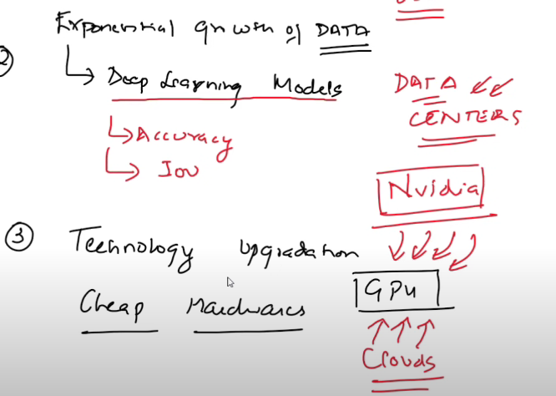
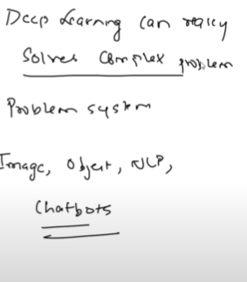
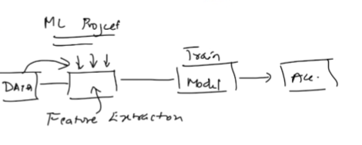
DL

Slide 4
AI vs ML vs DS vs DL and Semi supervised Learning
https://www.youtube.com/watch?v=J3nFOPoVnPw&list=PLZoTAELRMXVPGU70ZGsckrMdr0FteeRUi&index=3

Slide 5
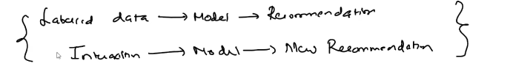
Semi supervised learning

Slide 6
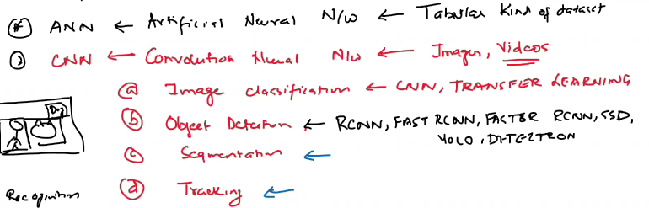
Deep Learning - types

Slide 7
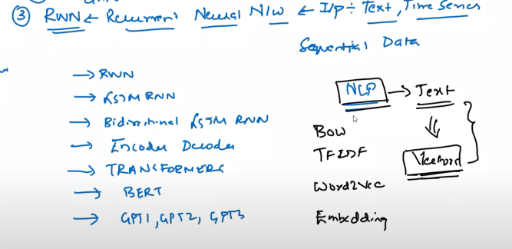
Deep Learning - types

Slide 8
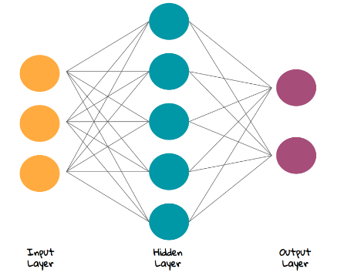
Neural Network - Backpropagation
Perceptron

Slide 9
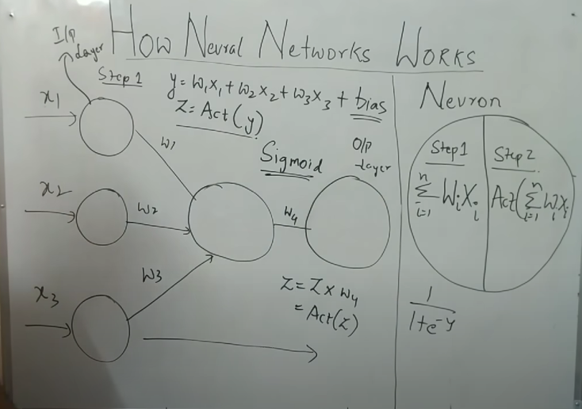

Slide 10
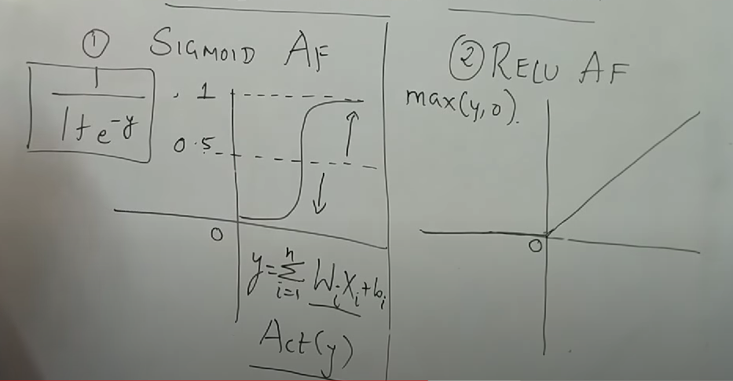

Slide 11
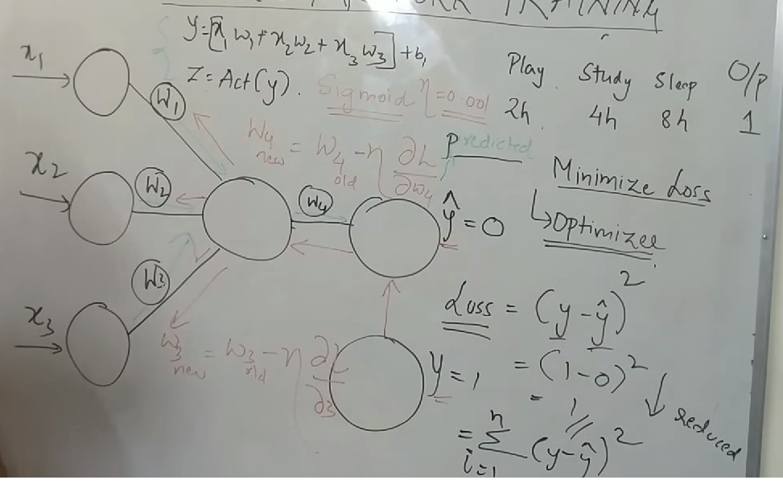
Backpropagation

Slide 12
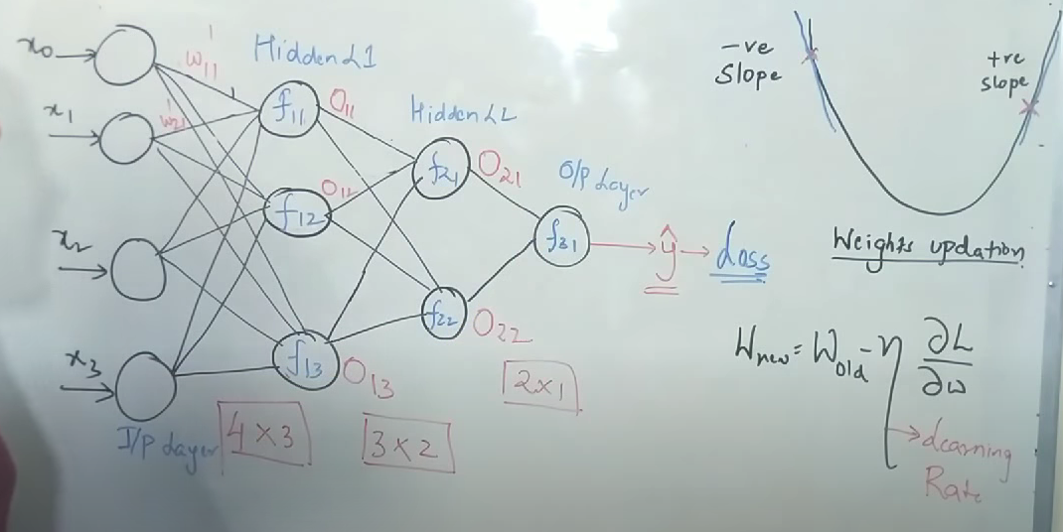
Gradient Descent

Slide 13
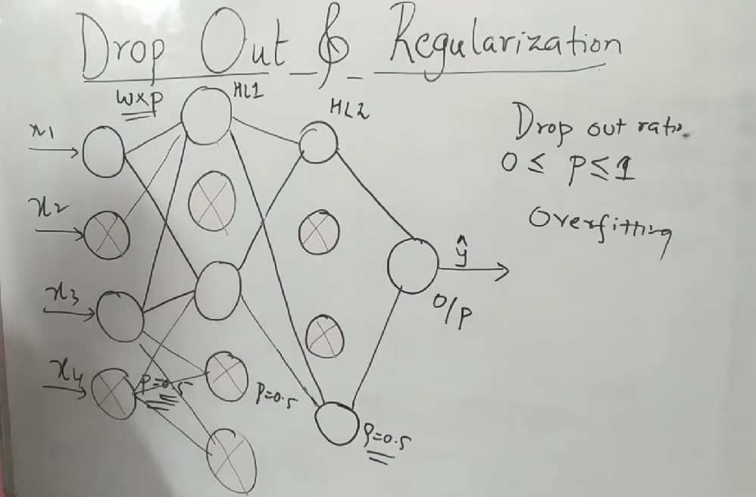
Drop Out and Regularization: Avoiding overfitting

Slide 14
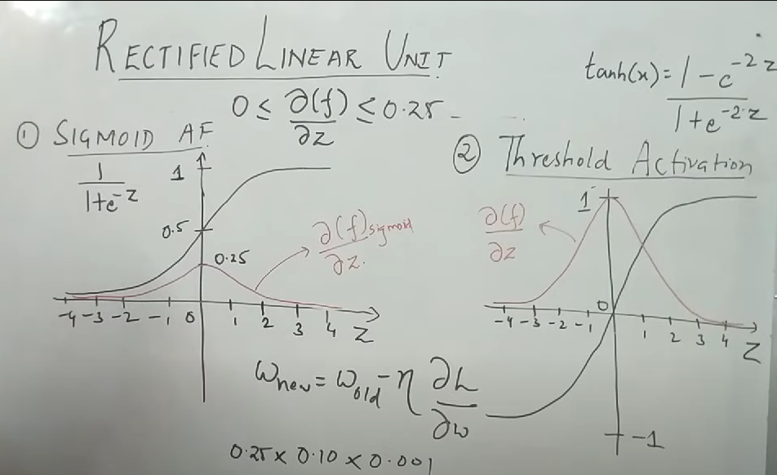
ReLu Activation Function vs Sigmoid

Slide 15
Weight Initialization
Weights should be small
Weights should not be the same
Weights should have a good variance

Slide 16
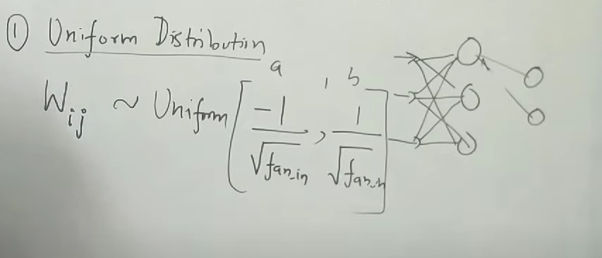
Weight Initialization : Uniform Distribution

Slide 17
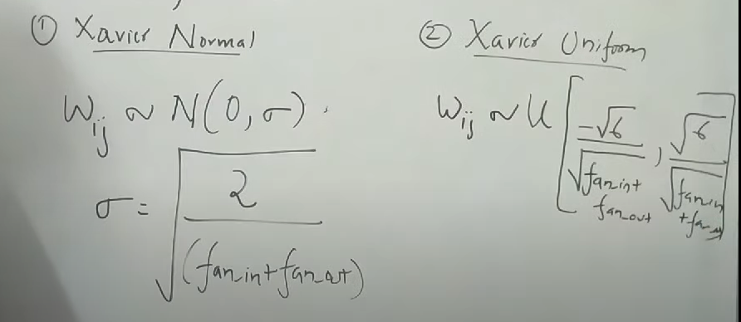
Xavier/Gorat

Slide 18
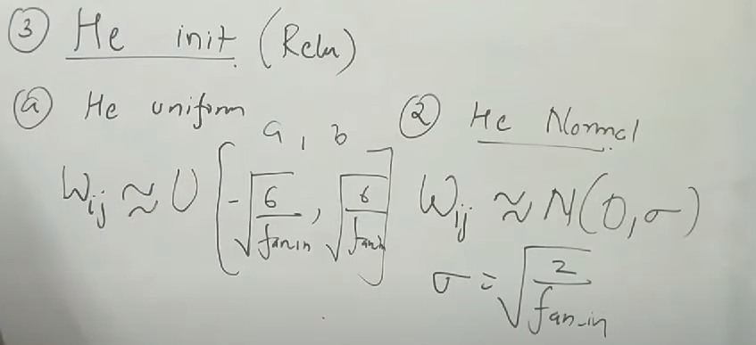
He init

Slide 19
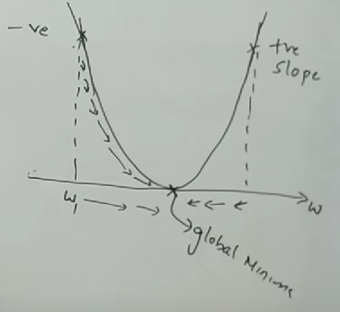
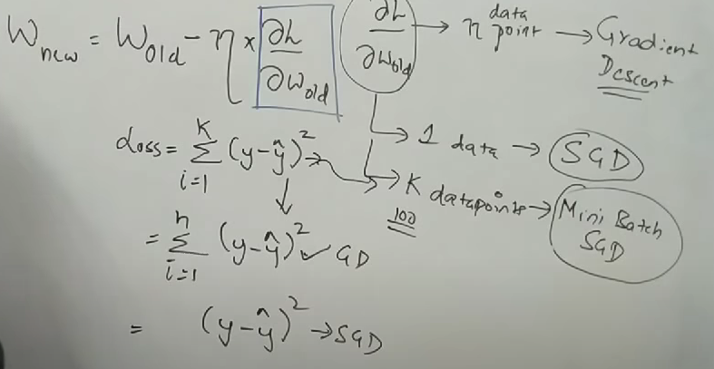
Stochastic Gradient Descent

Slide 20
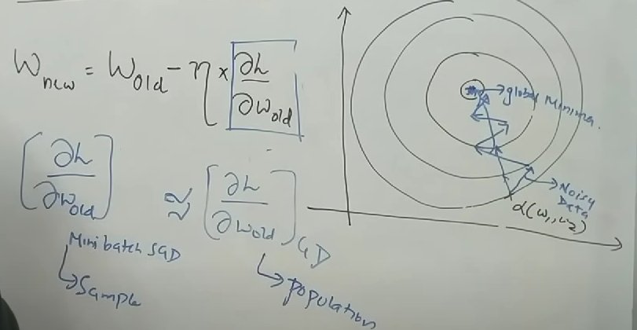
Stochastic Gradient Descent

Slide 21
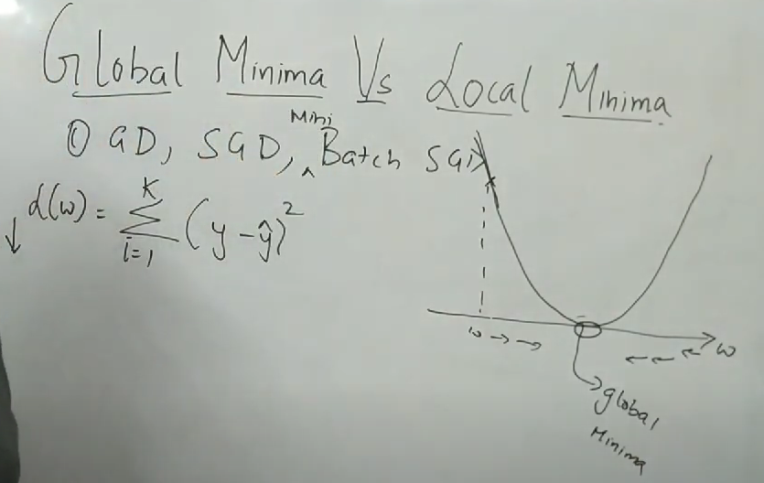
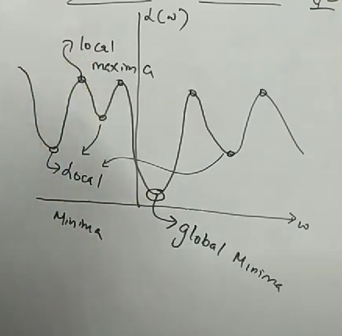
Global Minima

Slide 22
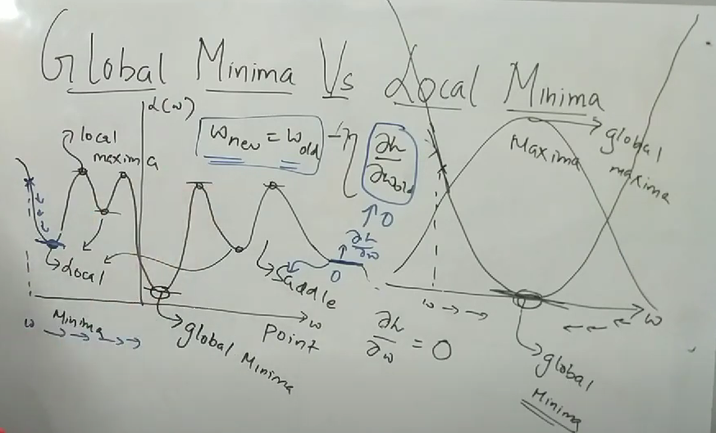

Slide 23
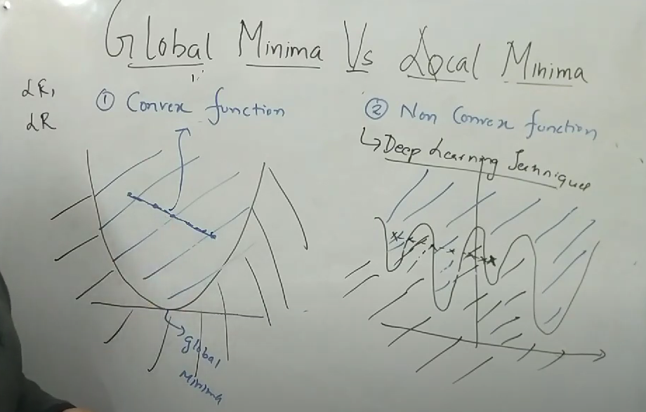

Slide 24
Optimizers
Optimizers are algorithms or methods used to minimize an error function(loss function)or to maximize the efficiency of production.
Optimizers are mathematical functions which are dependent on model’s learnable parameters i.e Weights & Biases.
Optimizers help to know how to change weights and learning rate of neural network to reduce the losses.

Slide 25
Optimizers
Gradient Descent
Stochastic Gradient Descent
Mini-batch Gradient Descent
SGD with momentum
AdaGrad (Adaptive Gradient Descent)
RMS-Prop
Ada-Delta
Adaptive Moment Estimation

Slide 26
How to choose optimizers?
If the data is sparse, use the self-applicable methods, namely Adagrad, Adadelta, RMSprop, Adam.
RMSprop, Adadelta, Adam have similar effects in many cases.
Adam just added bias-correction and momentum on the basis of RMSprop,
As the gradient becomes sparse, Adam will perform better than RMSprop.
https://medium.com/mlearning-ai/optimizers-in-deep-learning-7bf81fed78a0

Slide 27
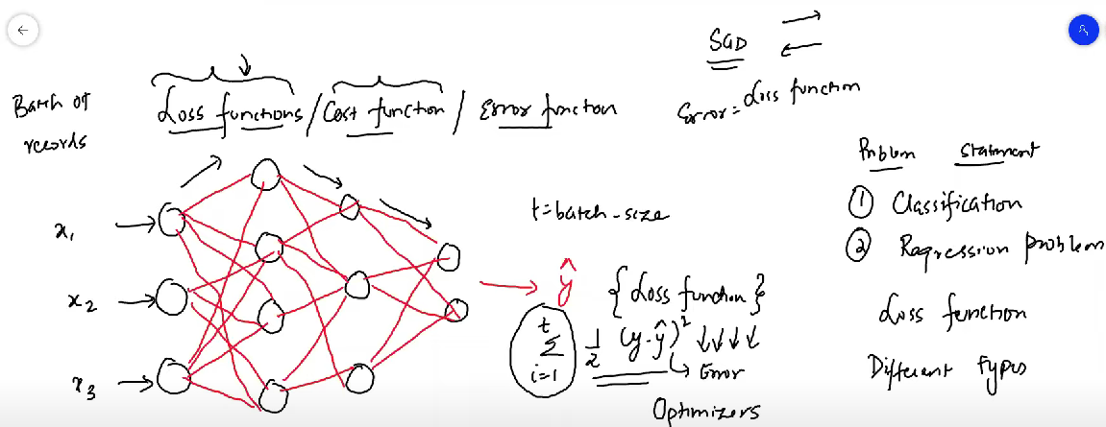
Loss function/Cost function

Slide 28
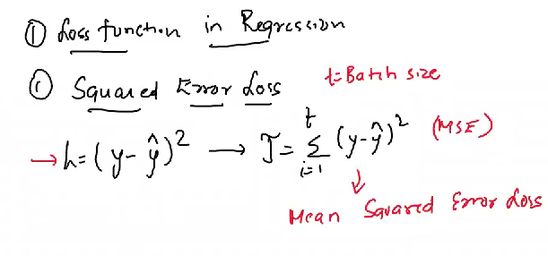
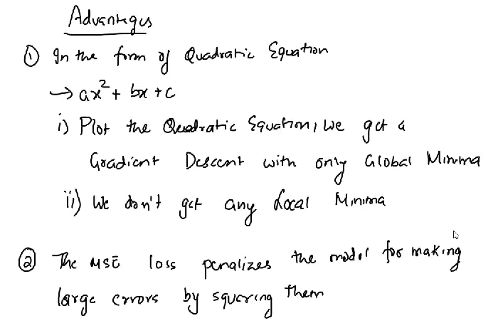
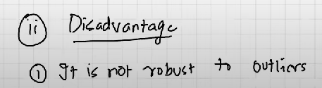
Loss Functions : Mean squared error

Slide 29
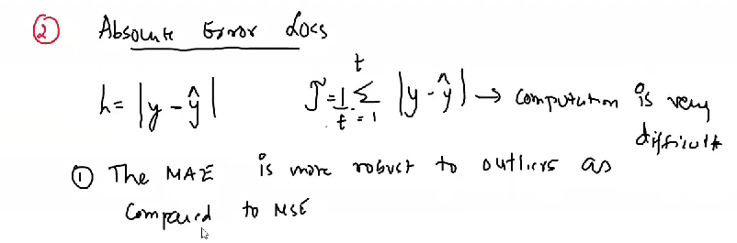
Absolute Error

Slide 30
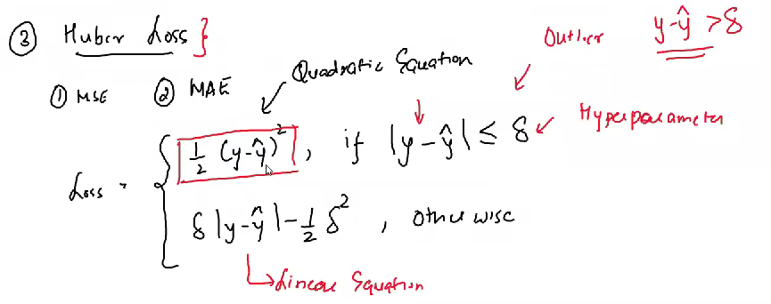
Huber Loss

Slide 31
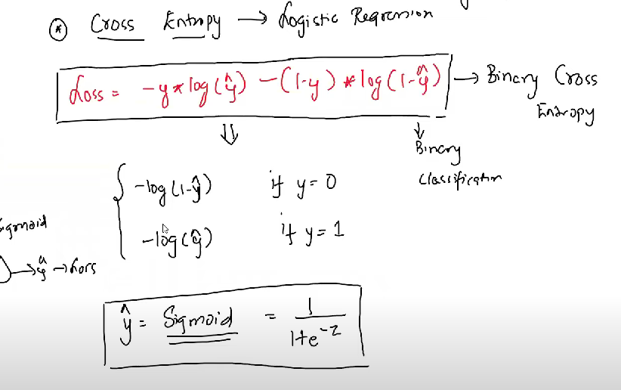
Classification: Entropy Loss

Slide 32
What platforms to use?
tensorflow ; keras > 2.0 (wrapper on tensorflow)
pytorch

